Slide 1
Classic Problems on Process Synchronization

Slide 2
Solution to critical section problem
Critical Section
  segment of code where shared variables are used
Solution must satisfy the following criteria
Correctness : Data synchronization and control synchronization
Maximum Concurrency : To provide execution speed up and good response time.
No Busy waits: This may lead to system degradation.

Slide 3
Semaphore
  A semaphore S is an integer variable that , apart from initialization , is accessed only through two standard atomic operations : wait() and signal ()
  Synchronization tool that does not require busy waiting
Less complicated
Can only be accessed via two indivisible (atomic) operations

Slide 4
Semaphore
Two standard operations modify S: wait() and signal()
  Originally called P() : Dutch word “proberen” - To wait
  V() : “vergohen” – to increment
wait (S) {
while (S <= 0)
; // no-op
S--;
}
  signal (S) {
  S++;
  }

Slide 5
Semaphore as Synchronization Tool
Provides mutual exclusion
  Semaphore S; // initialized to 1
  wait (S);
  Critical Section
  signal (S);
Binary semaphore – integer value can range only between 0 and 1; can be simpler to implement
  Also known as mutex, locks
Counting semaphore – integer value can range over an unrestricted domain
Counting semaphore S can be implemented a as a binary semaphore

Slide 6
Solution of other Synchronization Problem
Two processes P1 and P₂ are running concurrently: P₁ with a statement S₁ and P₂ with a statement S₂
Requirement:
  S₂ be executed only after S₁
Solution:
  Use a a semaphore variable sync initialized to 0
  … …
  S₁ wait(sync)
  signal(sync) S₂
  … …
  Process P₁ Process P₂

Slide 7
Semaphore Implementation
Must guarantee that no two processes can execute wait () and signal () on the same semaphore at the same time
Thus, implementation becomes the critical section problem where the wait and signal code are placed in the critical section.
  Could now have busy waiting in critical section implementation
    But implementation code is short
    Little busy waiting if critical section rarely occupied
Note that applications may spend lots of time in critical sections and therefore this is not a good solution.

Slide 8
Implementation without busy waiting
There is a waiting queue associated with each semaphore.
Each entry in a waiting queue has two data items:
  value (of type integer)
  a list of processes L waiting on this semaphore
  Typical example
  struct Semaphore {
  int value;
  ListOfProcess L;
  };
Two operations on process:
  block – place the process invoking the operation on the appropriate waiting queue.
  wakeup – remove one of processes in the waiting queue and place it in the ready queue.

Slide 9
Implementation without busy waiting
Implementation of wait:
  wait (s) {
  s.value--;
  if (s.value < 0) {
  add this process to waiting queue
  block();
  }
  }
Implementation of signal:
  signal (s) {
  s.value++;
  if (s.value <= 0) {
  remove a process P from the waiting queue
  wakeup(P);
  }
  }

Slide 10
Deadlock and Starvation
Deadlock – two or more processes are waiting indefinitely for an event that can be caused by only one of the waiting processes
Let S and Q be two semaphores initialized to 1
    P₀ P₁
wait (S); wait (Q);
wait (Q); wait (S);
. .
. .
. .
signal (S); signal (Q);
signal (Q); signal (S);
Starvation – indefinite blocking. A process may never be removed from the semaphore queue in which it is suspended.

Slide 11
Classical Problem of Synchronization
Bounded-Buffer Problem
  Producers produce information in a finite set of buffers; consumers consume the information.
  Goal: Smoothen out occassional mismatch of produce and consume rates
Readers and Writers Problem
  Some processes merely read some data, some others modify the data.
  Goal: Ensure consistency of data
Dining-Philosophers Problem
  Adjoining philosophers have to share forks with their neighbours.
  Goal: Ensure that they may eat without indefinite wait for forks

Slide 12
Bounded-Buffer Problem
Producer Cosumer processes with unspecified number
A producer must not write a full buffer
A consumer must not consume an empty buffer
Producers and consumers must access buffers in a mutually exclusive manner.
N buffers, each can hold one item
Optional condition:
  Information must be consumed in the same order in which it is created, i.e. in FIFO order

Slide 13
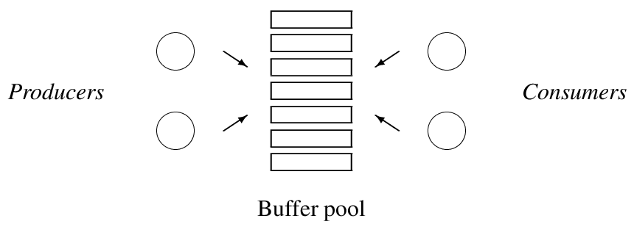
Producers and consumers

Slide 14
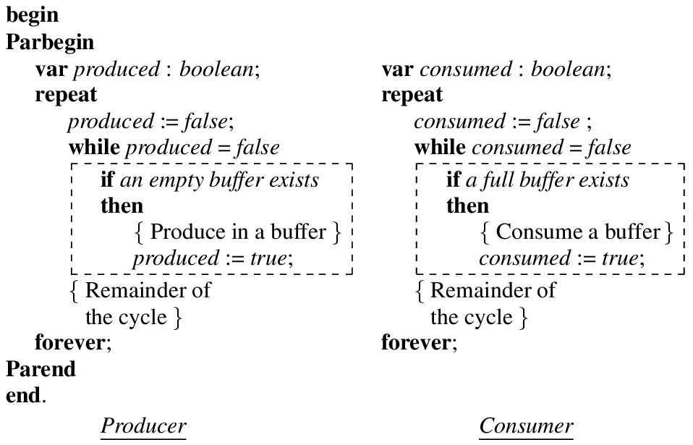
Solution outline for producers-consumers
(contains busy waits)

Slide 15
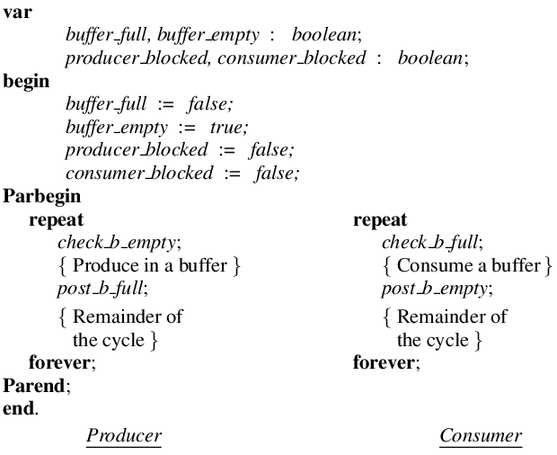
An improved outline for a simple producers-consumers system using signaling

Slide 16
Readers-Writers Problem
A data set is shared among a number of concurrent processes
  Readers – only read the data set; they do not perform any updates
  Writers – can both read and write.
Problem – allow multiple readers to read at the same time. Only one writer can access the shared data at the same time.

Slide 17
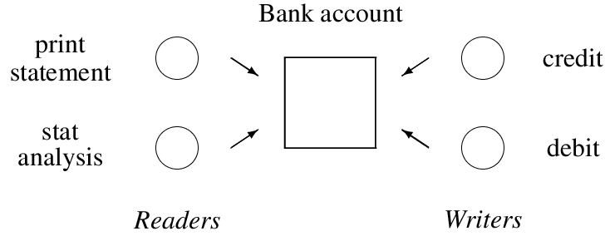
Readers and writers in a banking system

Slide 18
Readers and writers
Many readers may perform reading concurrently
Reading is prohibited while a writer is writing
Only one writer can perform writing
Optional condition:
  A writer should have priority over readers

Slide 19
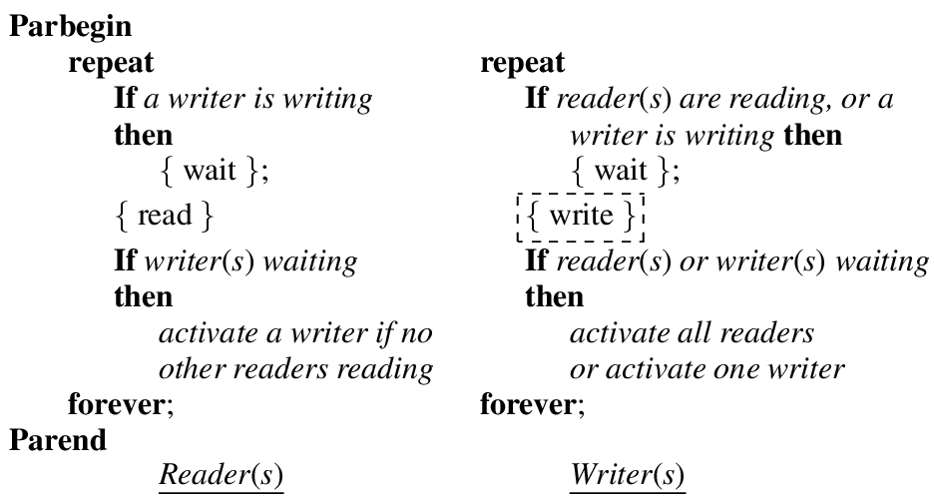
Solution outline for readers-writers without writer priority

Slide 20
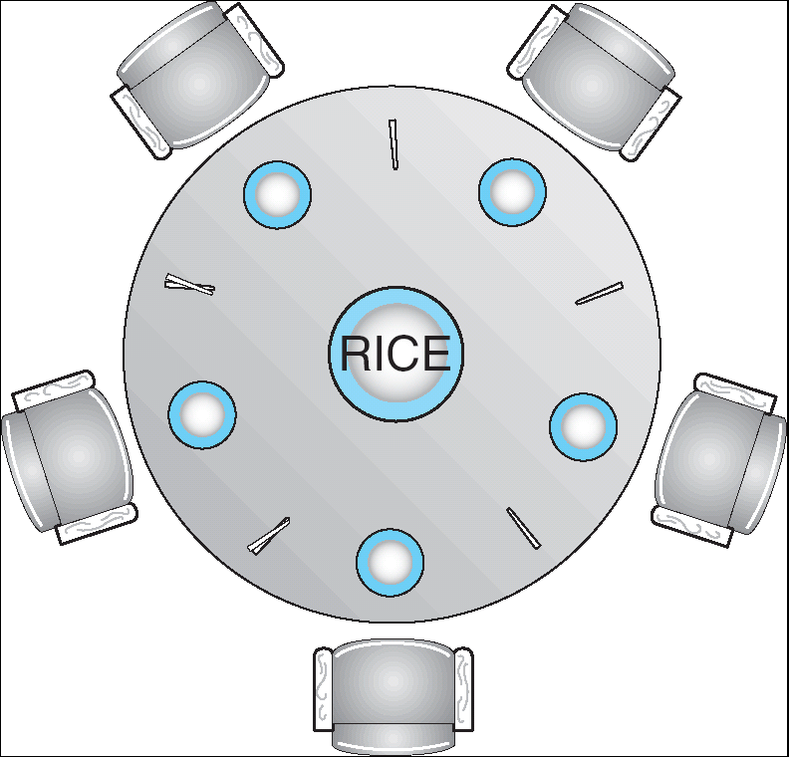
Dining-Philosophers Problem
Shared data
  Bowl of rice (data set) shared by 5 philosophers
  A fork is placed between each pair of philosophers
  To eat each philosopher must pick up two forks from left & right.
  Problem : A hungry philosopher should not face indefinite waits.

Slide 21
Dining-Philosophers Solution
Repeat
if left fork is not available
then
block (Pi);
Lift left fork;
if right fork is not available
then
block (Pi);
Lift right fork;
{eat}
If left neighbor is waiting for his right fork
then
activate (left neighbor );
If right neighbor is waiting for his left fork
then
activate (right neighbor );
{ think}
forever

Slide 22
Problem
If all philosophers simultaneously lift their left forks, none will be able to lift the right fork !ighe
Race condition can also come, because neighbors might fight over a shared fork.
We can avoid deadlocks, by modifying the process of allocation , so that if the right fork is not available , the philosopher would defer to his left neighbor by puttinf down the left fork and repeating the attempt to take the forks some time later.

Slide 23
Solution outline for dining philosophers
Repeat
successful:= false;
While (not successful)
if both forks are available then
lift the forks one at at a time;
successful:= true;
if successful:= false
then
block (Pi);
{eat}
Put down both the forks;
If left neighbor is waiting for his right fork
then
activate (left neighbor );
If right neighbor is waiting for his left fork
then
activate (right neighbor );
{ think}
forever

